Slide 1
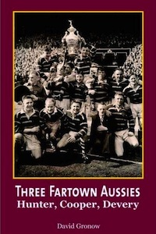
Huddersfield Rugby League Club have had many fantastic players who have moved from their homes in Australia to serve the club.
This is a book about three of them.

Slide 2
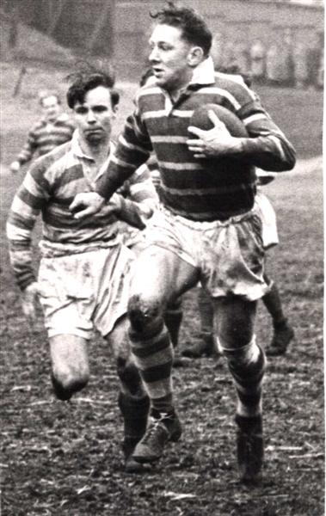
Lionel Cooper scored 420 tries for the club between 1947 and 1955.
Cooper would only sign for an English club if he could bring a friend to help him settle into life in the UK.
Plenty of clubs were keen on Cooper, but few were willing to risk buying the relatively unknown Johnny Hunter.

Slide 3
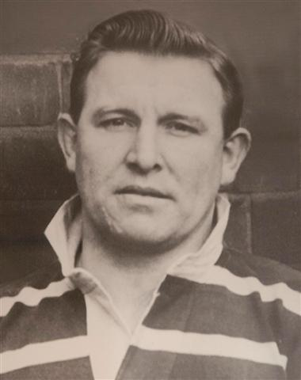
Johnny Hunter became a great full back who played for Huddersfield in their Challenge Cup winning team in 1953.

Slide 4
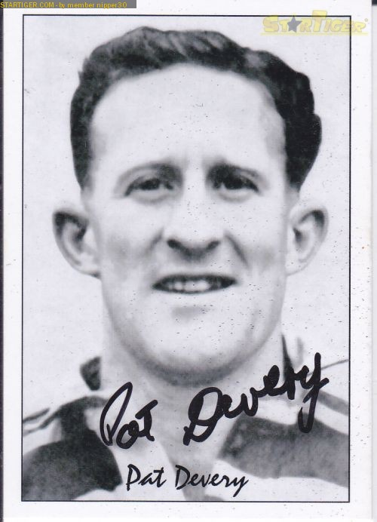
Pat Devery arrived at Huddersfield a year after Cooper and Hunter and went on to become a club legend.
He scored over one thousand points for Huddersfield.

Slide 5
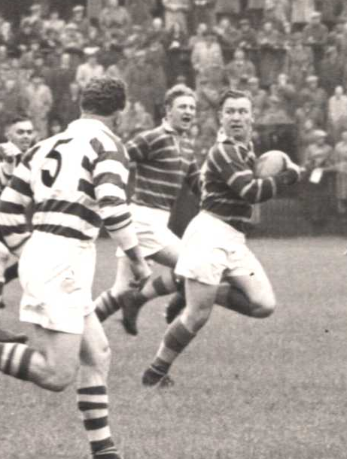
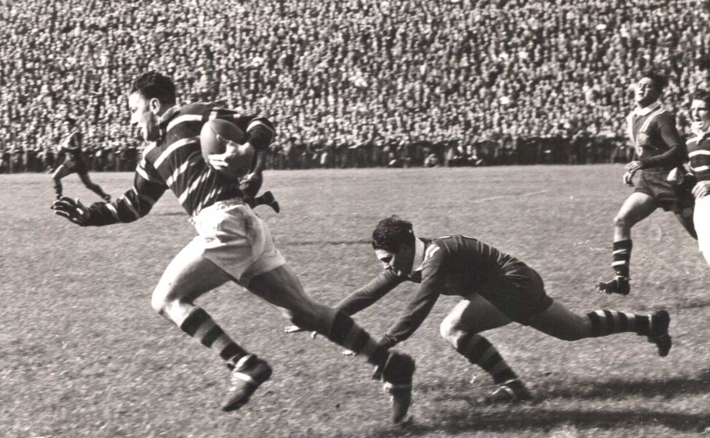
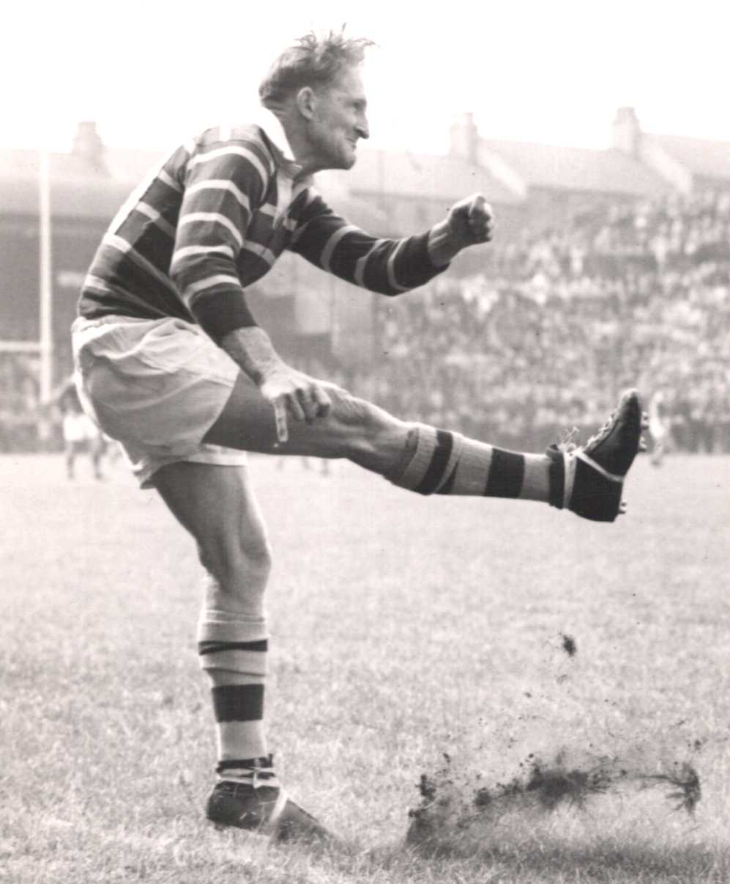
Older Huddersfield supporters still have clear memories of watching their ‘Hunter, Cooper, Devery’ team.

Slide 6
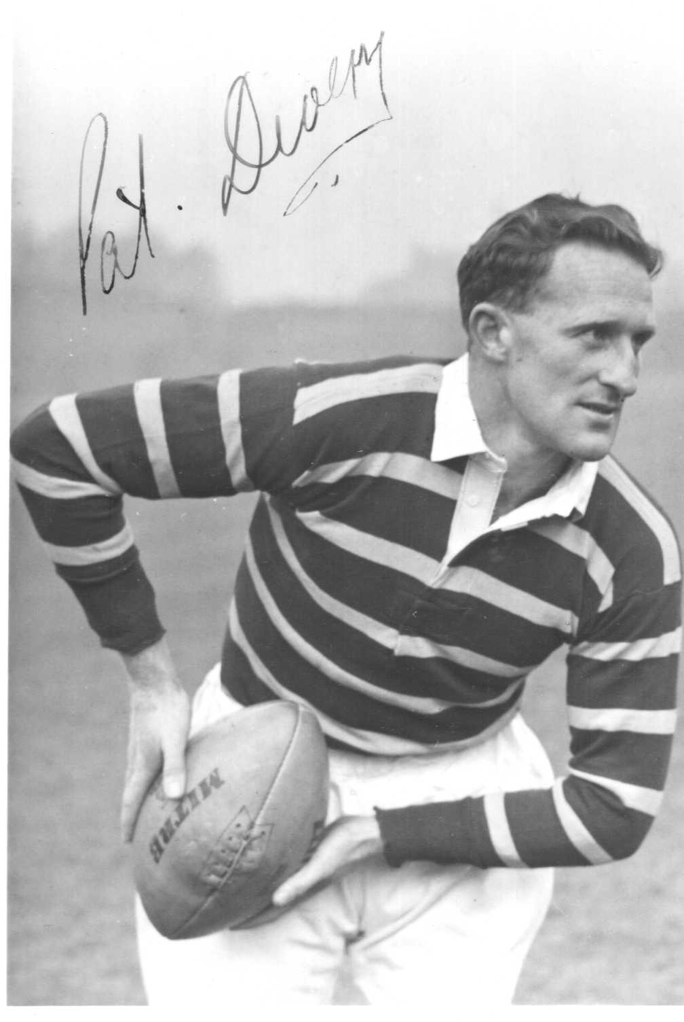
As a young man during the Second World War, Pat Devery served in the Australian Navy.
So too did the man we will learn about today

Slide 7
Claude Choules
The Last of the Last

Slide 8
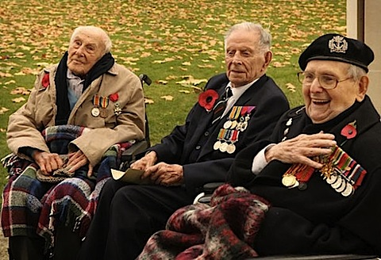
The last three servicemen living in Britain who fought in World War I all died in 2009 –
Henry Allingham, Harry Patch and Bill Stone.

Slide 9
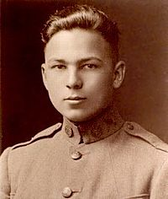
Frank Buckles was the last survivor from the US Army in World War I.
He drove ambulances to rescue the wounded from the battlefields in France and died in February 2011.

Slide 10
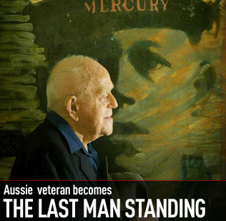
Claude Choules died on 5 May 2011 at the age of 110

Slide 11
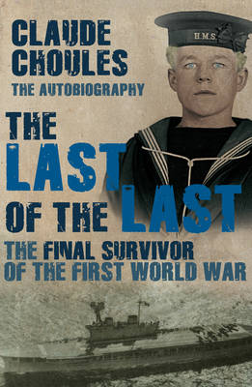
He was the last survivor to have fought in World War I (1914-18)

Slide 12
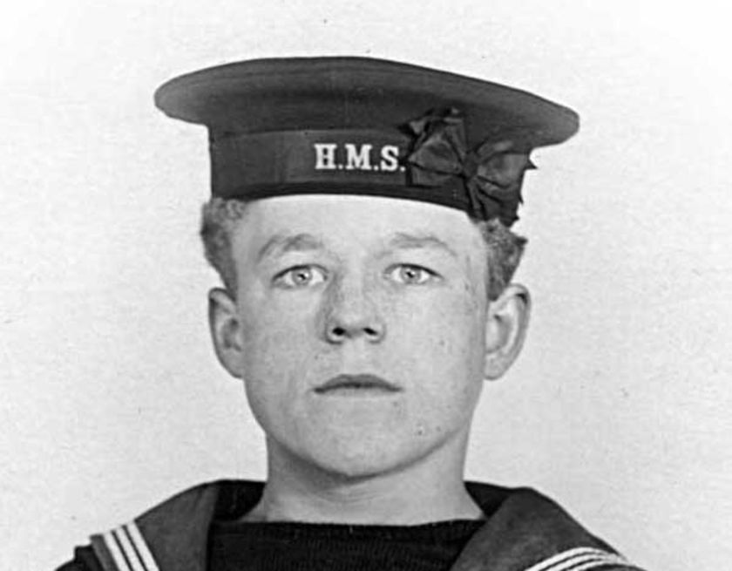
Mr Choules was born in Pershore, Worcestershire, on March 3 1901, six weeks after the death of Queen Victoria.

Slide 13
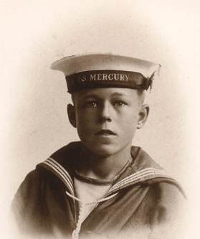
His mother Madeline, a Welsh actress, left the family home when he was five.
He was told she had died but in fact she had returned to the stage, and he never saw her again.

Slide 14
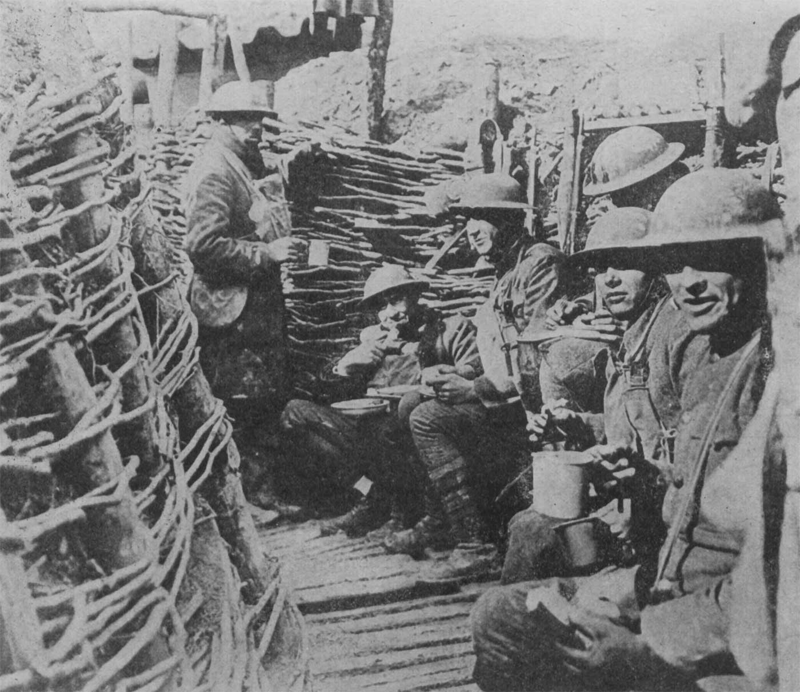
His two elder brothers had emigrated to Australia in 1911 and joined the Australian Army.
Both fought in the terrible Gallipoli campaign in Turkey.

Slide 15
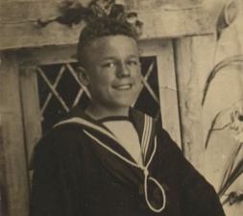
Claude wanted to join them in the fight against Germany so tried to enlist in the Army as a bugler boy when he was 14.
The Army turned him down because of his age.
His father Harry suggested he should try the Royal Navy and he signed up for naval training in 1915 at the age of 14.

Slide 16
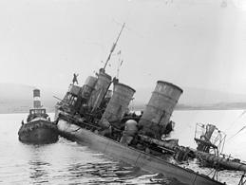
Claude witnessed the scuttling of the German fleet at Scapa Flow in 1919.

Slide 17
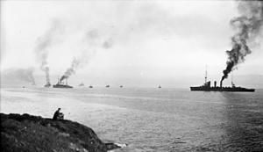
This was when the German navy sank their own ships as part of the peace terms at the end of World War I.

Slide 18
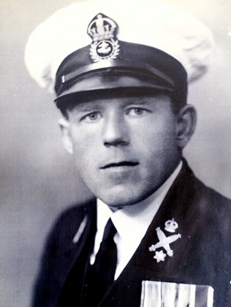
Claude remained with the Royal Navy after the war and in 1926 was posted as an instructor to Melbourne in Australia.
While on board the passenger liner that took him to Australia he met a children’s nurse from Scotland called Ethel Wildgoose.

Slide 19
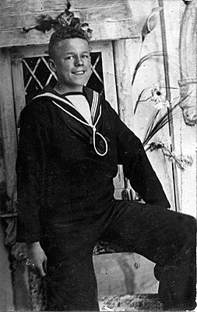
Later Claude described her as “tall and brunette, a real stunner”.
They were married on December 3 1926 and later settled in Western Australia and were married for almost 80 years.

Slide 20
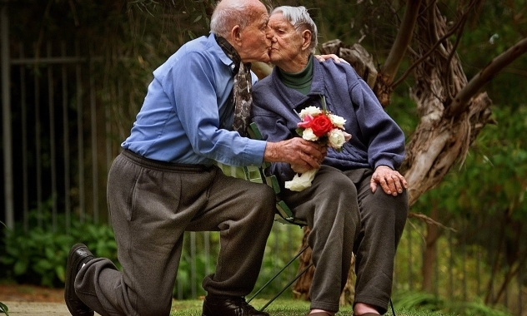
They were married for 76 years until Ethel died aged 98 in 2003

Slide 21

In the 1930s, Claude transferred to the Royal Australian Navy.
During World War II he became chief demolition officer for the western half of Australia.
If Japan had invaded Australia he would have had to blow up Freemantle Harbour, leaving it useless to the enemy.
He remained in the Australian navy until his retirement at the age of 55 in 1956.

Slide 22
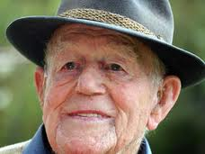
For the next 10 years Claude operated a boat catching crayfish off the coast of Western Australia.

Slide 23
He took a creative writing course at the age of 80 and recorded his memoirs for his family.
These became his autobiography, ‘The Last of the Last’ which was published in 2009.

Slide 24
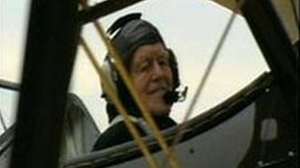
Claude stayed active into his old age.
On his 103rd birthday his family arranged for him to go up in an old aeroplane.

Slide 25
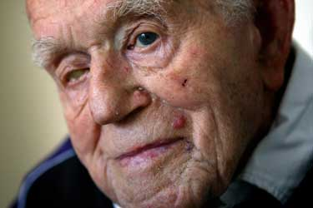
One by one his fellow veterans passed away and although his body was failing, his mind remained alert until the end.
"I'm lucky aren't I, to be surviving all that time," he once told the BBC. "If I had my time over again I wouldn't change a bit of it."

Slide 26
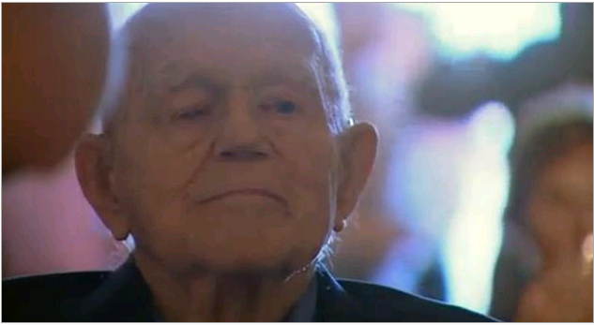
Nicknamed ''Chuckles'' by his fellow sailors, Claude used to tell those who asked the secret of his long life…
… was to ''keep breathing!''

Slide 27
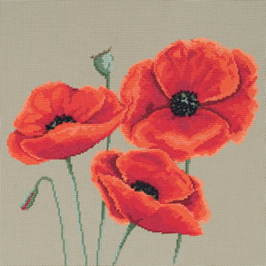
Every November, people wear their poppies to remember all those who have fought in wars
Now there are no survivors from World War I we should promise…
“We will remember them”.

